Slide 1
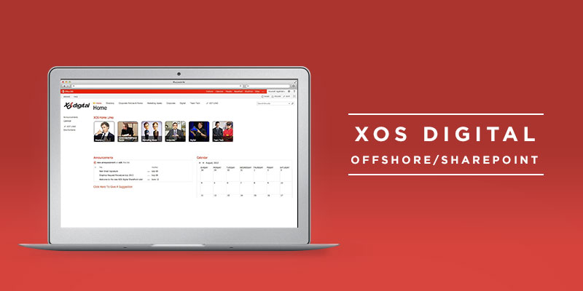
XOS Digital SharePoint
The Challenge
<p>XOS Digital was happy with the design, and site was successful in launching. During the project Affirma learned valuable knowledge about the limitations of SharePoint file and data size management.</p>
<p>&nbsp;</p>
<p>XOS Digital, a company that provides digital asset management solutions, facility design, integration services and digital coaching technologies, came to Affirma with an existing 2010 SharePoint site that they wanted to migrate to 2013. In Addition, XOS asked Affirma to create a highly customized design for them, one which would communicate their brand across all pages.</p>
<p>&nbsp;</p>
What We Did
<ul>
<li>Affirma was given the SharePoint wireframes from the existing site with all of its information, and designed and configured a new site.</li>
<br />
<li>The configuration included new security groups, which were needed and applied down to folder level.</li>
<br />
<li>SharePoint size limits were a major hurdle for this migration. To address this issue, Affirma reconfigured the SharePoint site so that instead of one site collection there were four, functioning together as one, and excluded unnecessary file types, such as SQL backups, large video files, etc.</li>
<br />
<li>&nbsp;</li>
</ul>
Results

